Slide 1
Designing Fair Machine Learning Model
Deborah D. Kanubala & Angel Gabriel
20.06.2025

Slide 2
Content
Motivation
Why Fairness is hard problem
Sources of discrimination
Case Study of COMPASS
Measuring Discrimination
Demographic Parity
Equality of opportunity
Equalized odds
Mitigation Approaches
Preprocessing
Reweighting
Inprocessing
Using Lagrangian Approach
Post Post processing
Equalized Odds/Equality of opportunity

Slide 3
Part I: Motivation

Slide 4
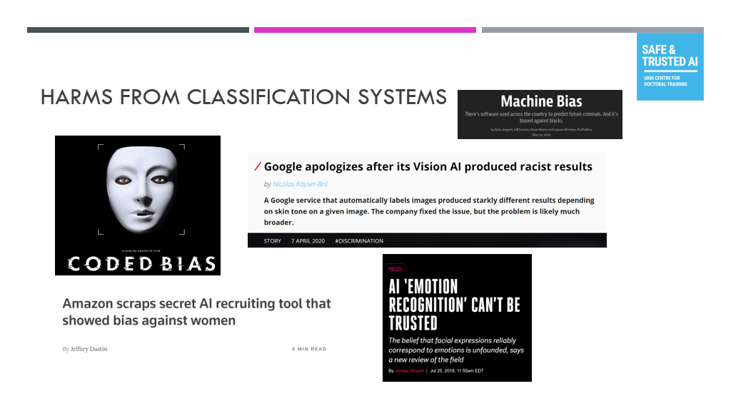
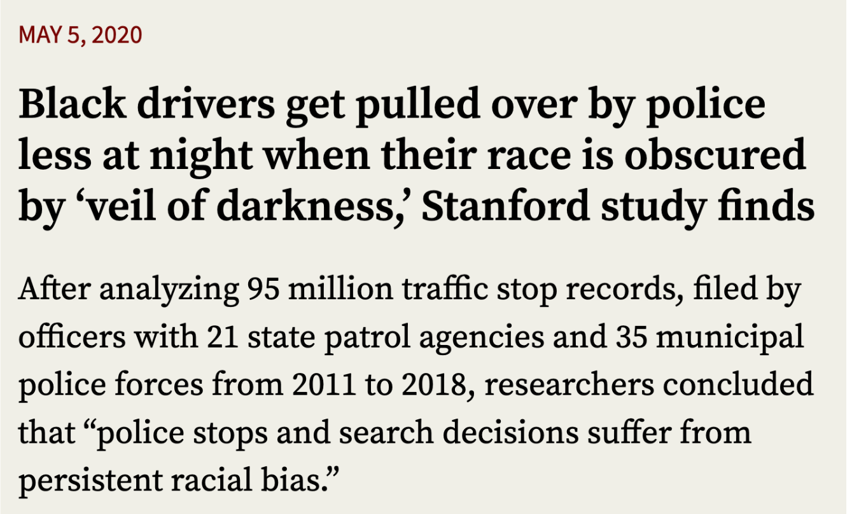
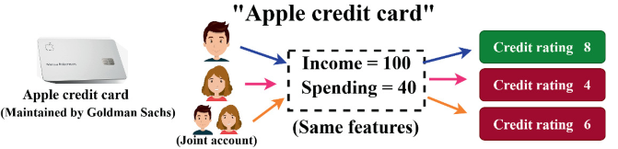
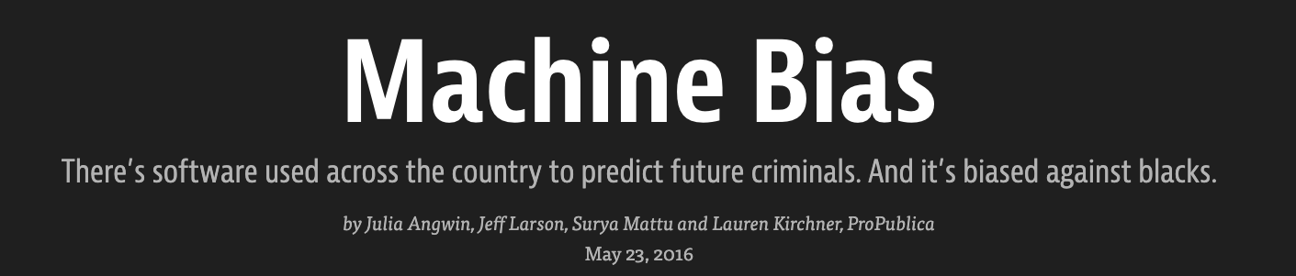
Motivation
Image from: Joshua Loftus

Slide 5
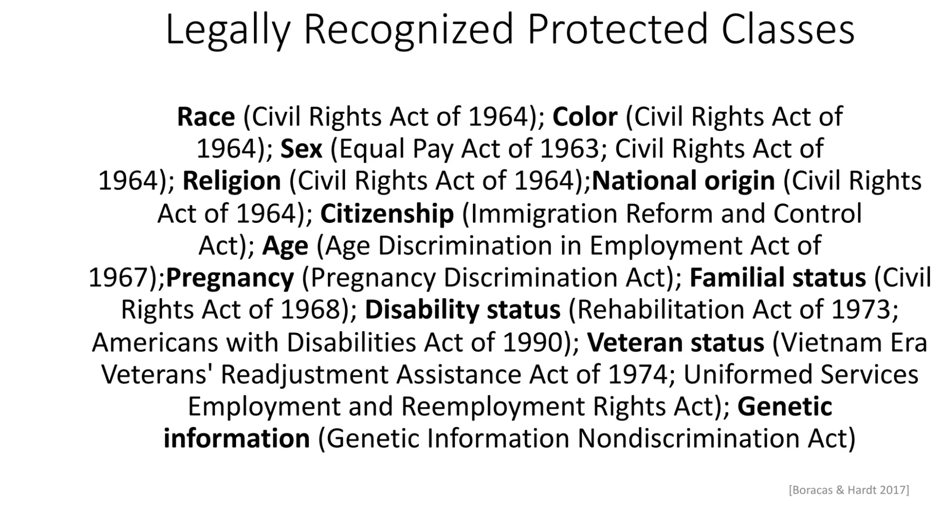
Protected Attributes

Slide 6
Sources of Bias
Sample Bias: Occurs when one population is overrepresented or underrepresented in a training dataset.
Label Bias: Occurs when annotation process introduce bias during creation of training data.
Outcome proxy Bias: Occurs when the ML task is not specified appropriately. (Arrest - > Police arrest, Cost of health system -> quality of health.)
Human Biases in Historical data: Historical data contains human biases and stereotypes.

Slide 7
Why Fairness is Hard using COMPASS as case Study

Slide 8
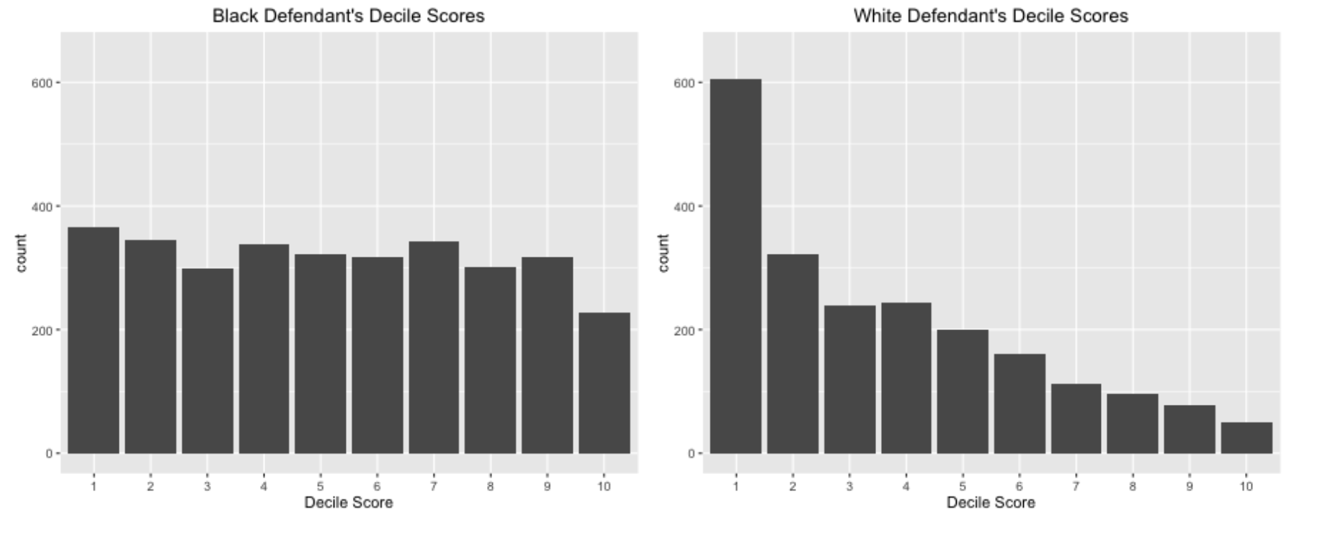
Compass Study Case
2016 ProPublica article analyzed COMPAS scores for >7000 people arrested in Broward county, Florida
Question: How many of these people ended up committing new crimes within 2 years?
Reference: https://www.propublica.org/article/how-we-analyzed-the-compas-recidivism-algorithm

Slide 9
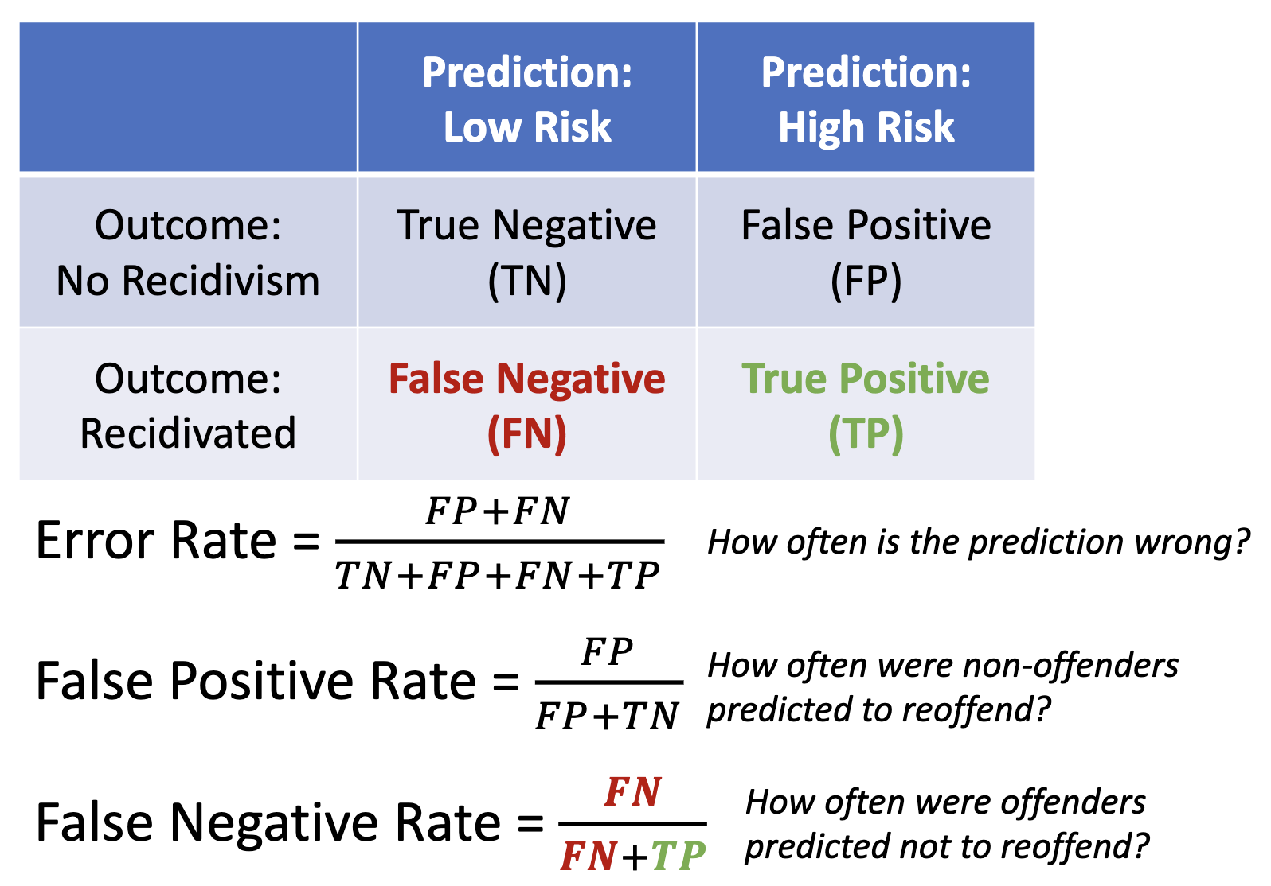
Error Metrics
Defendants care
about this
Judges care
about this

Slide 10
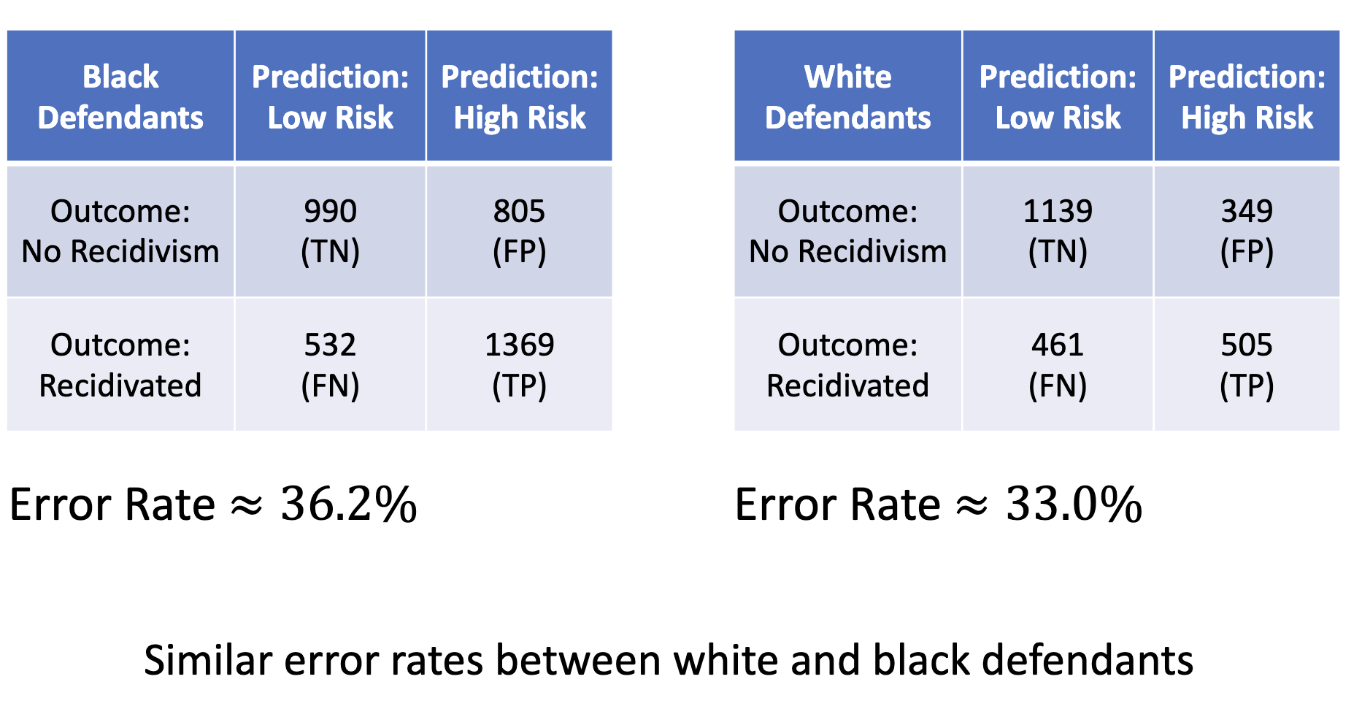
Error Estimation

Slide 11
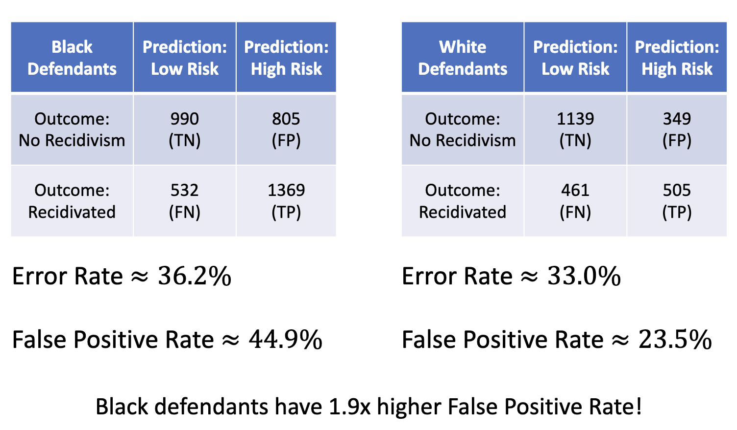
Error Estimation

Slide 12
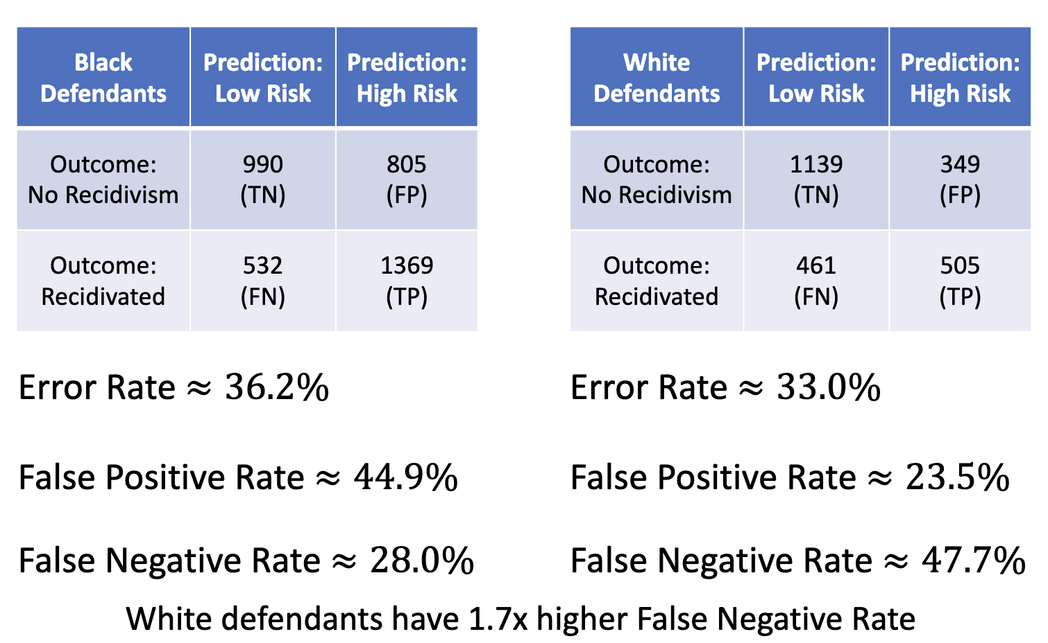
Why Fairness is Hard

Slide 13
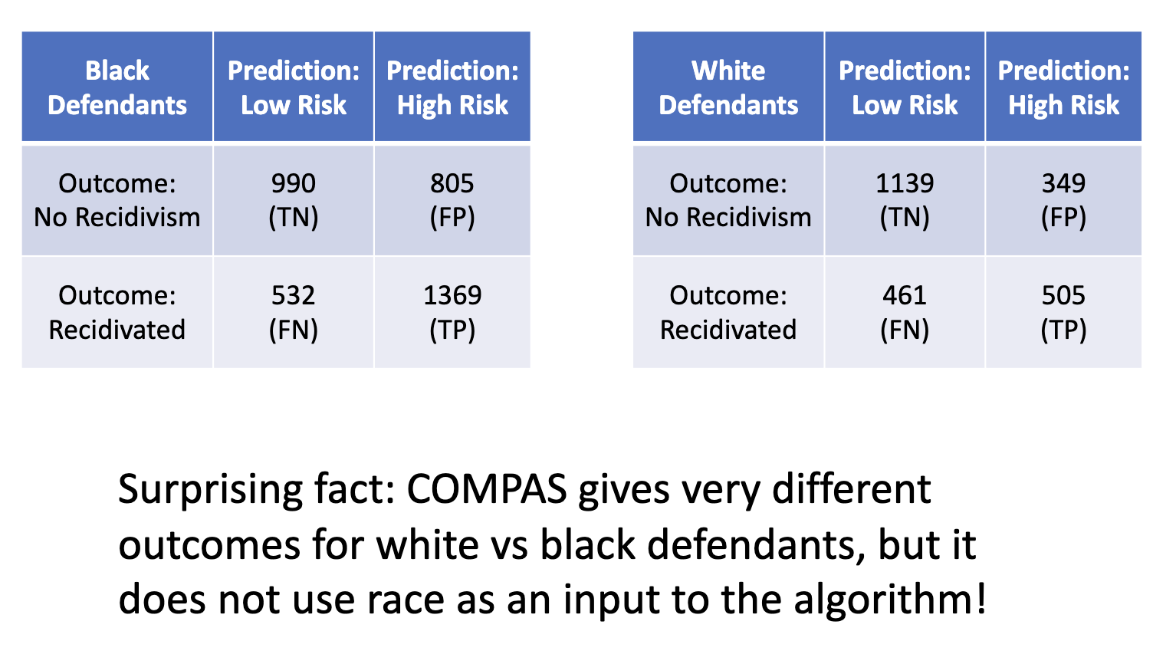
Why Fairness is Hard
Fairness through unawareness

Slide 14
Why Fairness is hard
⚖️ Tension | 💡 What it looks like in practice | 🚀 Take-away
Which metric to satisfy? | Demographic parity, equalized odds, calibration, predictive parity … you can’t have them all at once ( impossibility theorems ). Choosing one redistributes harm/benefit. | Metric choice is a normative decision, not only technical.
“Fairness through unawareness” doesn’t work | Dropping the sensitive feature leaves proxies (zip code ⇒ race, career gaps ⇒ gender). The model re-learns group labels and bias becomes harder to spot. | Blindness ≠ fairness; auditable visibility is required.
Data imbalance & representation | Minority classes often have sparse, noisy labels; majority groups dominate the loss signal. Over-sampling or re-weighting can help, but may inflate variance. | Garbage in → garbage out; fix upstream data as well as models.

Slide 15
Types of Fairness
Individual Fairness: Similar individuals should be treated similarly.
Group Fairness: Outcomes of a decision making system should not differ systematically between two demographic groups.
Counterfactual Fairness: Outcomes of an algorithm would not changed if in a counterfactual world if the individual had a different demographic characteristics.

Slide 16
Part II: Measuring Discrimination

Slide 17
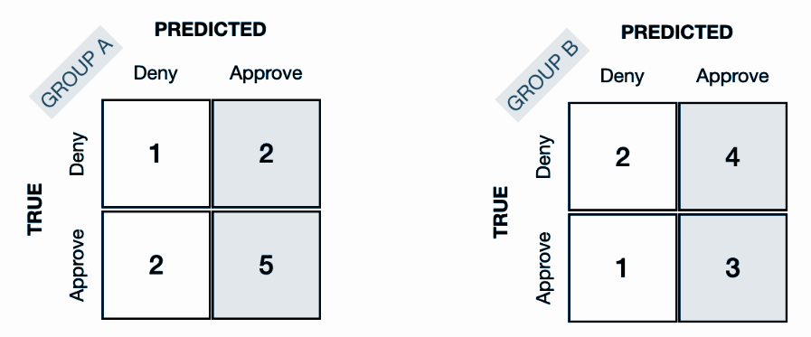
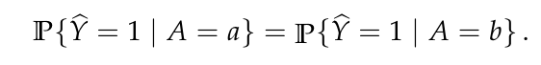
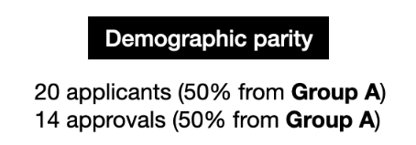
Demographic Parity
Demographic parity is a fairness metric whose goal is to ensure a machine learning model’s predictions are independent of membership in a sensitive group.

Slide 18
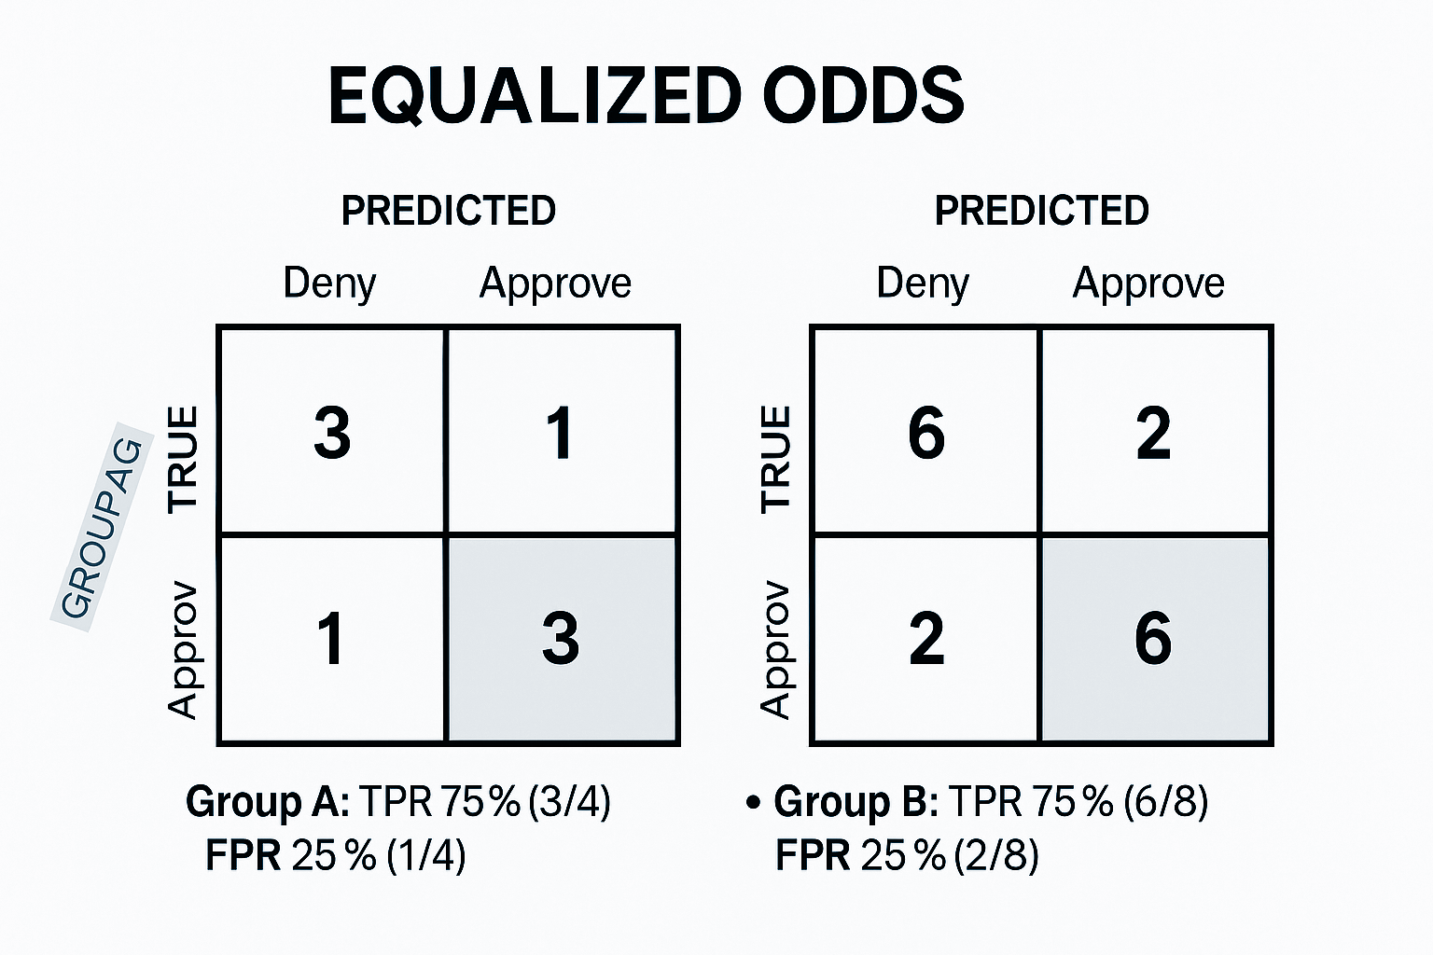
Equalized Odds
The goal of the equalized odds fairness metric is to ensure a machine learning model performs equally well for different groups.
It requires that the machine learning model’s predictions are not only independent of sensitive group membership, but that groups have the same false positive rates and true positive rates.

Slide 19
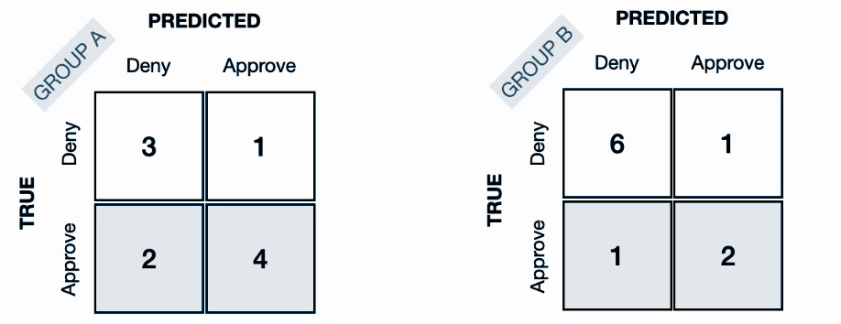
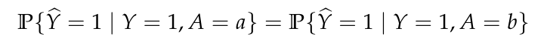
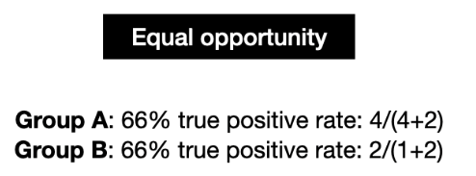
Equality of Opportunity
Equal opportunity is a relaxed version of equalized odds that only considers conditional expectations with respect to positive labels, i.e.,

Slide 20
Interactive tool https://research.google.com/bigpicture/attacking-discrimination-in-ml/

Slide 21
Part III: Mitigation Discrimination

Slide 22
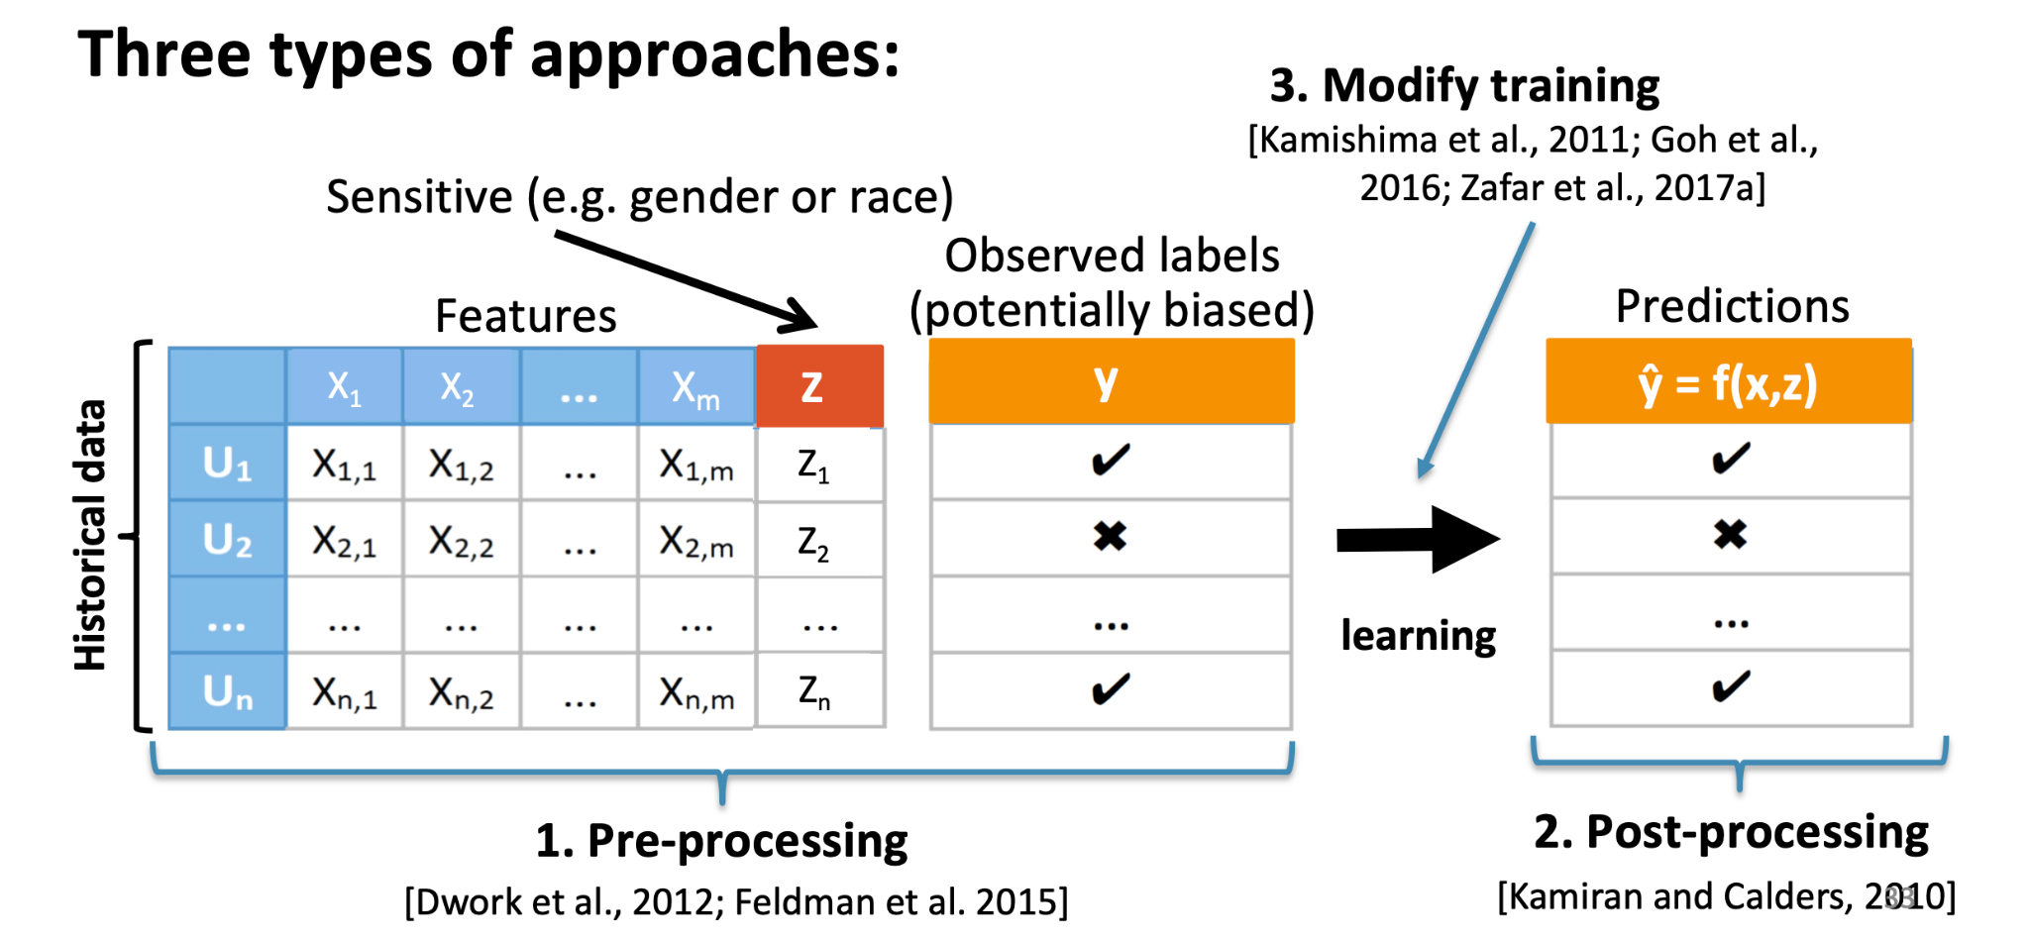
Fairness Mitigation Approaches
Picture from Core ML Lecture Saarland University

Slide 23
Pre Processing Approach
Reweighting generates weights for the training samples in each (group, label) combination differently, ensuring fairness before classification
Higher weights are assigned to instances that are underrepresented and lower weights are assigned to instances that are overrepresented.
Additional methods:
Fair Representations
Finds a latent representation that encodes the data well.
Disparate Impact Remover
Edits feature values to increase group fairness while preserving rank ordering within groups

Slide 24
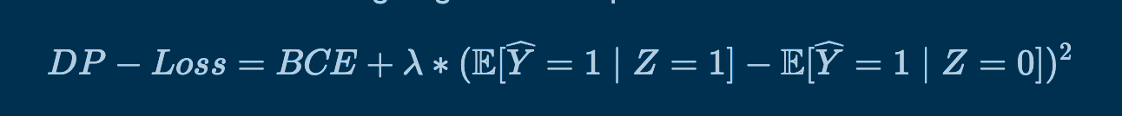
Adversarial Debiasing
Learns classifier to maximize prediction accuracy and simultaneously reduces adversary’s ability to determine protected attribute from predictions
Prejudice Remover
Adds a discrimination aware regularization term to the learning objective
Meta Fair Classifier
Takes fairness metric as part of the input and returns a classifier optimized for the metrics
In Processing Approach
Example using Demographic Parity as a metric
MLE loss binary cross entropy. Can be squared, hinge etc
Controls the strength of fairness
Fairness metric. For example, here it demographic parity bit can be replace with equality of opportunity etc

Slide 25
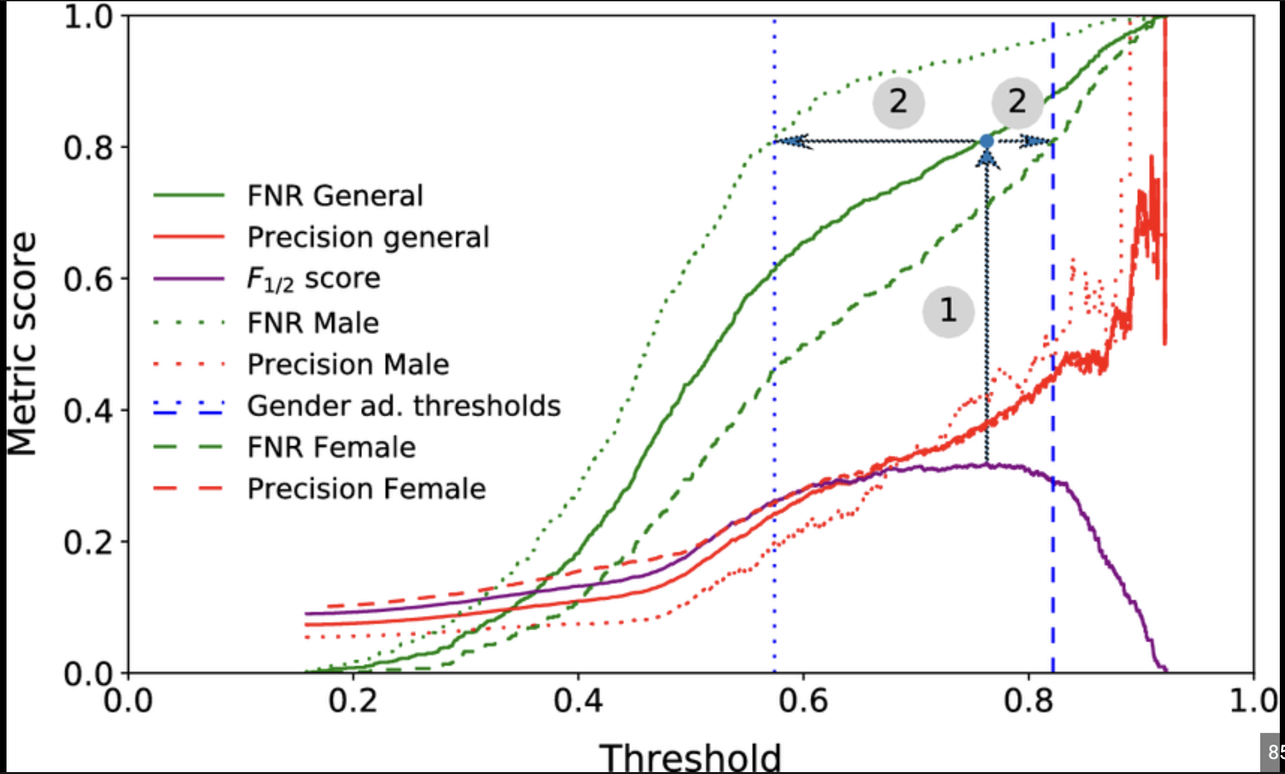
Post Processing Approach
Reject option classifier:
Changes predictions from classifier to make them more fair.
Equalized Odds:
Modifies predicted label using an optimization scheme to make predictions more fair
Threshold Optimizer

Slide 26
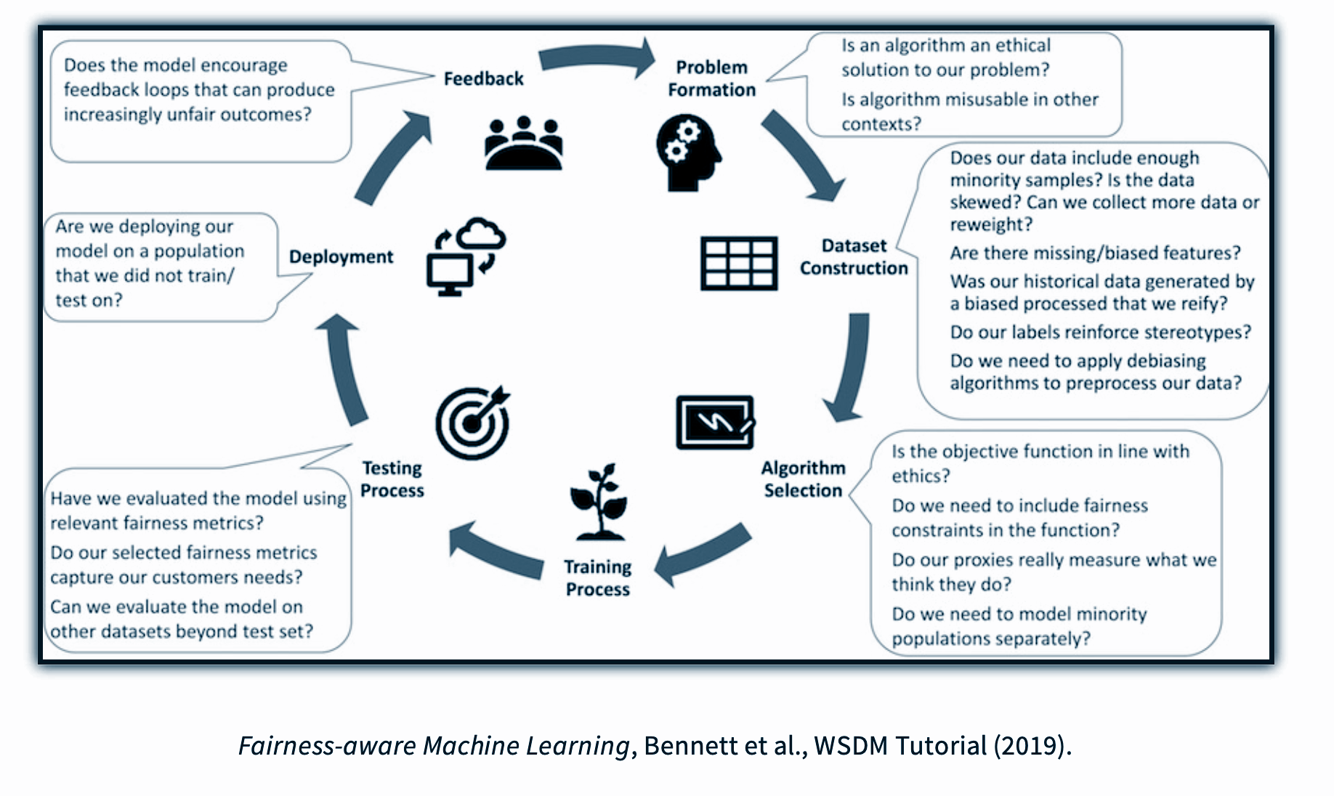
Building Fair Models

Slide 27
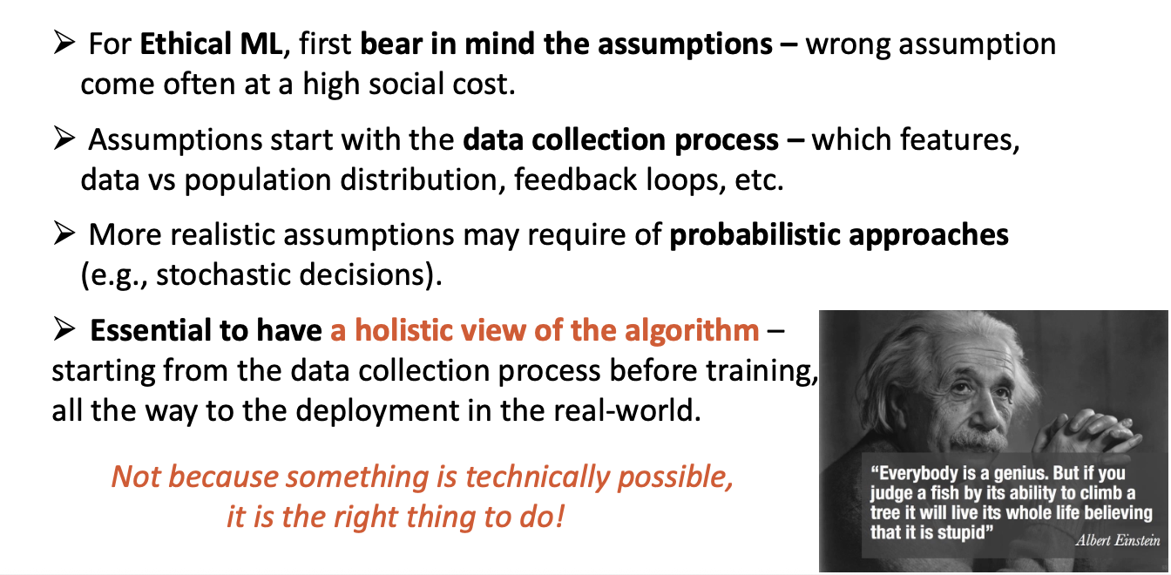
Take Home Message
Picture from Core ML Lecture Saarland University

Slide 28
Slides developed using the following materials
Slides: Justin Johnson & David EECS 442 WI 2021 lecture: https://web.eecs.umich.edu/~justincj/slides/eecs442/WI2021/442_WI2021_lecture18.pdf
AI Fairness Learn about four different types of fairness. Assess a toy model trained to judge credit card applications: https://www.kaggle.com/code/alexisbcook/ai-fairness

Slide 29
Additional materials for interested participants
Fairness Tutorial Notebook: https://colab.research.google.com/drive/1HN-sLQXQ3hClQbv3OyGUX9uEujQLBbwj#scrollTo=Ik_FsjBWhJfX
What is Fair about Individual Fairness: https://philsci-archive.pitt.edu/18889/1/Fleisher%20-%20Individual%20Fairness.pdf
Equality of Opportunity in Supervised Learning: https://arxiv.org/pdf/1610.02413.pdf
AI Fairness How to measure and Reduce Unwanted Bias in ML: https://krvarshney.github.io/pubs/MahoneyVH2020.pdf
AIF360 Library: https://aif360.res.ibm.com/
A Survey on Bias and Fairness in Machine Learning: https://arxiv.org/pdf/1908.09635.pdf
A clarification of the nuances in the fairness metrics landscape: https://www.nature.com/articles/s41598-022-07939-1
Fairness in ML Survey paper: https://dl.acm.org/doi/pdf/10.1145/3616865

Slide 30
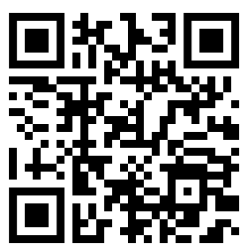
Feedback Form

Slide 31
THANK YOU FOR YOUR ATTENTION
If you have any questions or interested in learning or doing research in this area, please contact: dkanubala@aimsammi.org or

